Slide 1


2021
Netcoreconf
Data Visualization with Power Bi
Francisco Cruzado Perni
Development Architect @ AnalyticAlways
Associate Professor @ IE
27/02/2021
@ocoloco

Slide 2



Slide 3
Agenda
01. Introduction
02. Connecting Power BI to App Insights
03. Initial Dashboard
04. Storytelling with Data in Five Steps
05. Building an Alternative Dashboard

Slide 4
01. Introduction
What are we going to talk about?
Data Visualization in general
Dos and don’ts
Connecting Power BI to Azure (briefly)
Using Power BI to visualize data
Storytelling with data
What are NOT we going to talk about? (today …)
Advance Power BI
Query data from different sources
Connecting different datasources

Slide 5
Working with data
Data gathering
Data wrangling or munging
Data exploration
Data visualization

Slide 6


Data visualization
Graphical representation of data

Slide 7
02. Connecting Power BI to App Insights
API deployed in Azure
App Service
App Insights
Query app Insights in portal
Query app Insights in Power BI
Visualize imported data in Power BI

Slide 8
Demo 1: Connecting Power BI to App Insights
Demo!

Slide 9
03. Initial Dashboard
Exagerating but close to reality
There will be alternatives later
But there is no single answer to how to display data

Slide 10
Demo 2: Initial Dashboard
Demo!

Slide 11
04. Data Visualization in Five Steps
Context
Visual Display
Declutter
Focus attention
Narrative structure

Slide 12

Context
Who
Your audience
You
What
Action
Mechanism
Tone
How
Storyboarding

Slide 13
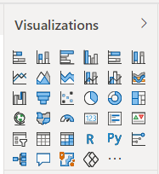
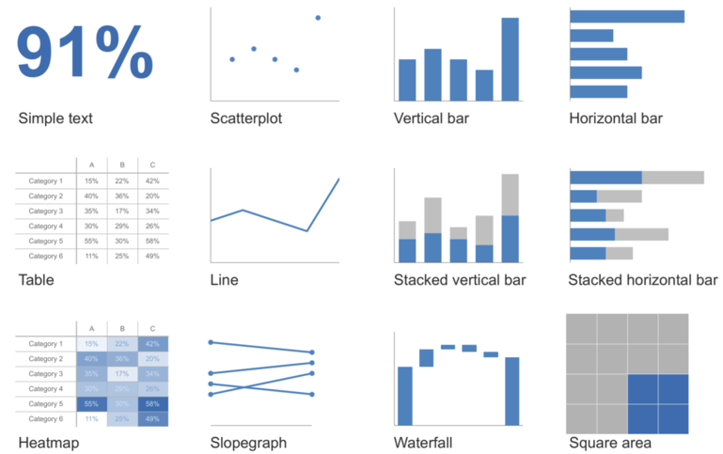
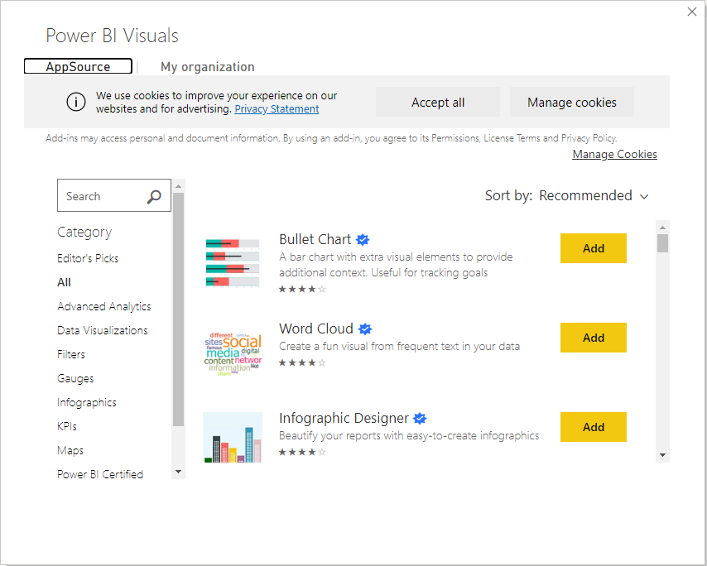
Visual Display
Source: Nussbaumer Knaflic, Cole. Storytelling with data: a data visualization guide for business professionals (Wiley 2015).

Slide 14
Demo 3: I hate pies!
Demo!

Slide 15
Demo 4: Displaying geographical data … Always in a map?
Demo!

Slide 16

Declutter
Cognitive load
Reduce the effort
Clutter
Reduce the noise

Slide 17
Declutter – General rules
Remove gridlines
Remove chart border
Remove point markers on data series
Clean up horizontal axis, a.k.a. x-axis
Label series directly and remove legend
Remove unused space
Insert legend information directly on visualization

Slide 18
Demo 5: Cleaning up the house
Demo!

Slide 19

Focus attention
Pre-attentive attributes
Color
Form
Size
Position

Slide 20
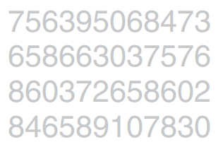
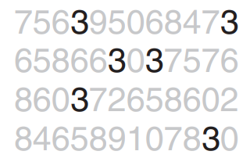
Focus attention

Slide 21
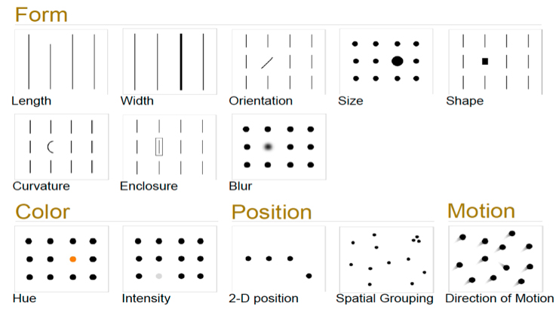
Focus attention
Source: Few, Stephen Show Me the Numbers: Designing Tables and Graphs to Enlighten (Analytics Press, 2012).

Slide 22
Focus attention
Seven suggestions about color:
Color grabs attention.
Color can signal where to look.
Color should be used sparingly.
Color can carry quantitative value.
Color carries tone and meaning.
Not everyone sees color.
Color should be used consistently.

Slide 23
Demo 6: Highlighting insights
Demo!

Slide 24

Narrative structure
Constructing the story
Beginning
Middle
End

Slide 25
05. Building an Alternative Dashboard
Follow concepts seen before
Use existing KPIs to filter other visualizations
Effective use of space
Every element MUST have a purpose
DRY: Don’t repeate yourself

Slide 26
Demo 7: Alternative dashboard
Demo!

Slide 27
Demo 8: Storytelling with data
Demo!

Slide 28
Extra – Bibliography & Recommended Readings
Storytelling with Data: A Data Visualization Guide for Business Professionals
http://www.storytellingwithdata.com
Cole Nussbaumer Knaflic. Wiley (2015).
How Charts Lie
http://albertocairo.com
Alberto Cairo. W.W Norton & Company (2019)

Slide 29
Q & A
Ask me!

Slide 31
More information:
info@netcoreconf.com
@Netcoreconf
Visit on:
netcoreconf.com
Thanks

